Slide 1
Creating Your Own Blog/Website
Major Project

Slide 2
Recommend an appropriate WordPress plugin for each of the given scenarios:
Create a contact form: Contact Form 7
Perform on-page SEO: Yoast SEO
Avoid spam on your website: Akismet
Import ready-to-use templates: Elementor
Add a chatbot: Elementor

Slide 3
Write and publish a blog post on any one of the given topics. Add the link to your blog post.
Top 5 Digital Marketing tools in 2022 : Unleashing the Power of Digital Marketing: Top 5 Tools in 2022 – AR Tech (wordpress.com)
Step-by-step process of installing, activating, and deactivating a WordPress plugin : A Beginner’s Guide: Installing, Activating, and Deactivating WordPress Plugins – AR Tech
Best restaurants in your city : Culinary Delights: Exploring the Best Restaurants in Vijayawada – AR Tech (wordpress.com)
Top 10 cars to buy in 2022 within 10 lakhs : Driving Excellence: Top 10 Cars Under 10 Lakhs in 2022 – AR Tech (wordpress.com)

Slide 4
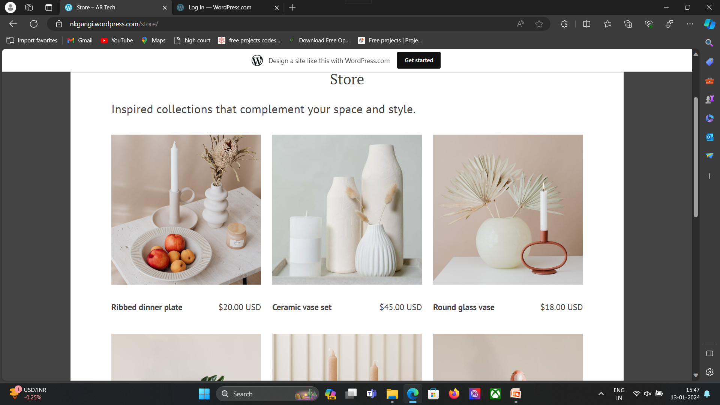
Choose any one landing page from below and try to replicate it as much as possible using Elementor. Install relevant plugins and templates that are required. Attach a full-page screenshot of your landing page along with the link.
Store – AR Tech (wordpress.com)

